Slide 1
Blog Website
By Desmond Wallace

Slide 2
Description
This is a Blogging web application built using the .NET Core framework along with Reactjs for UI construction. MySQL is the database of choice for storing the necessary information of this web app.

Slide 3
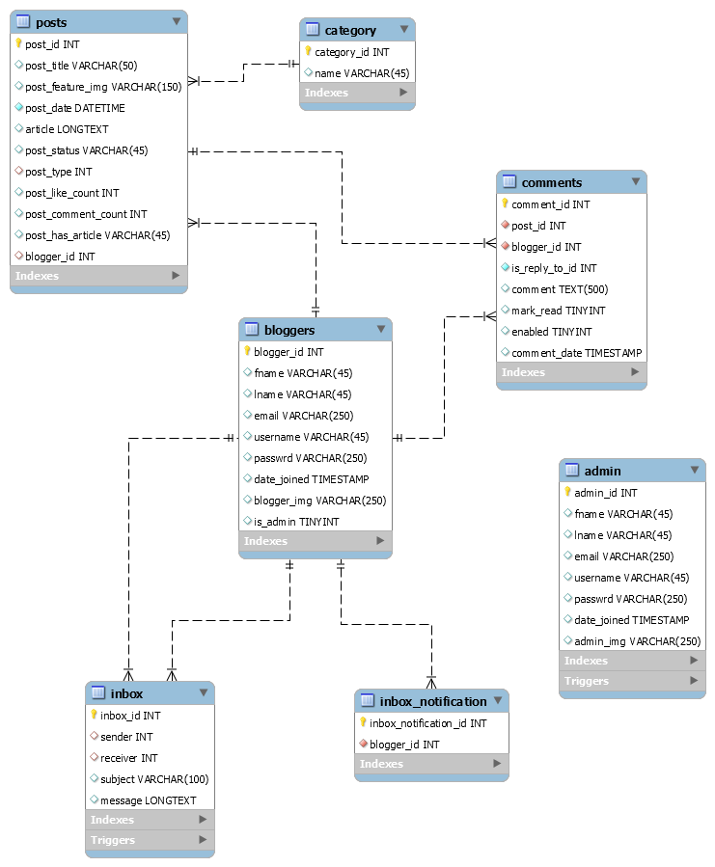
Database diagram

Slide 4
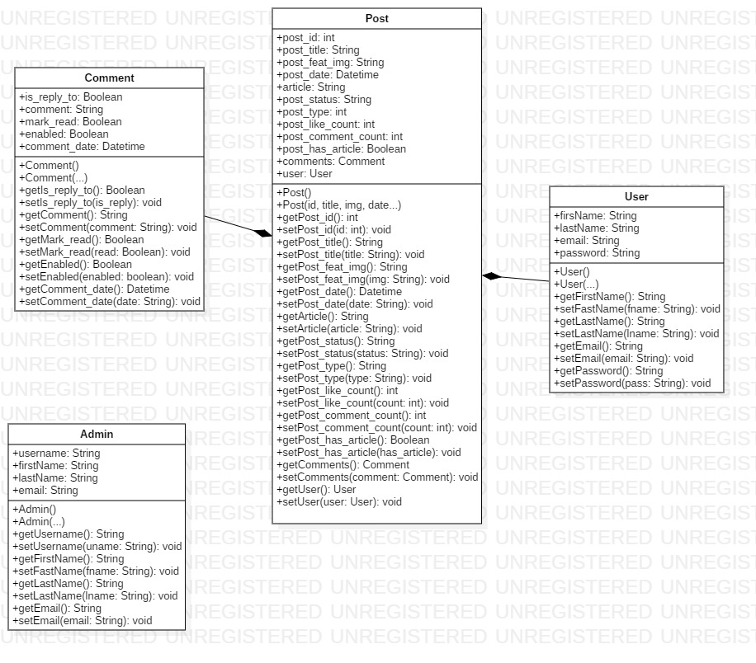
Class diagram

Slide 5
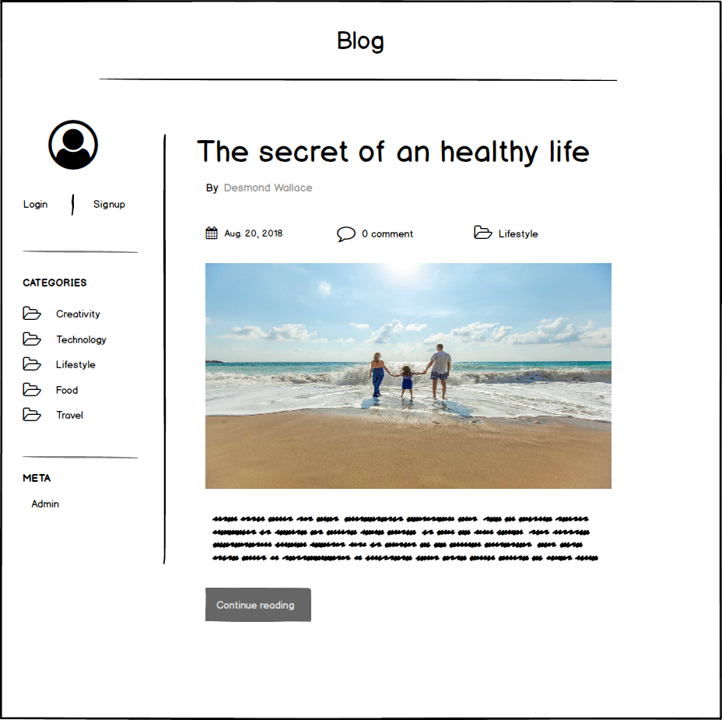
Home page

Slide 6
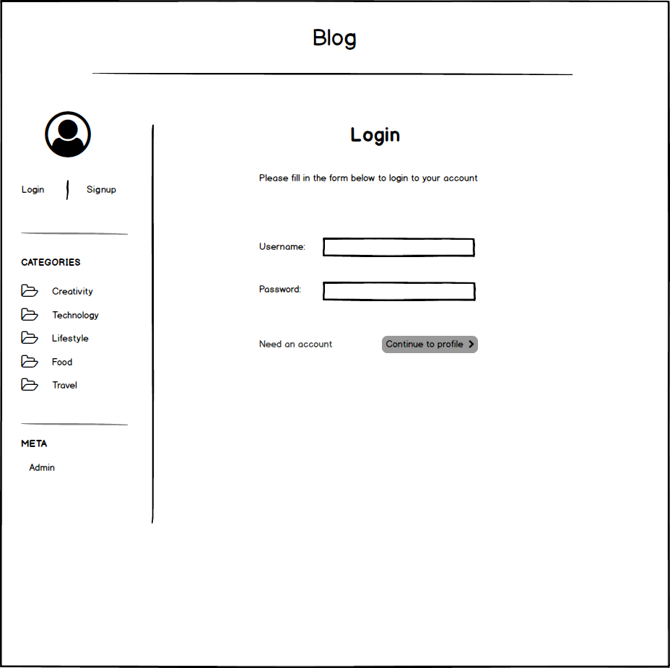
Login page

Slide 7
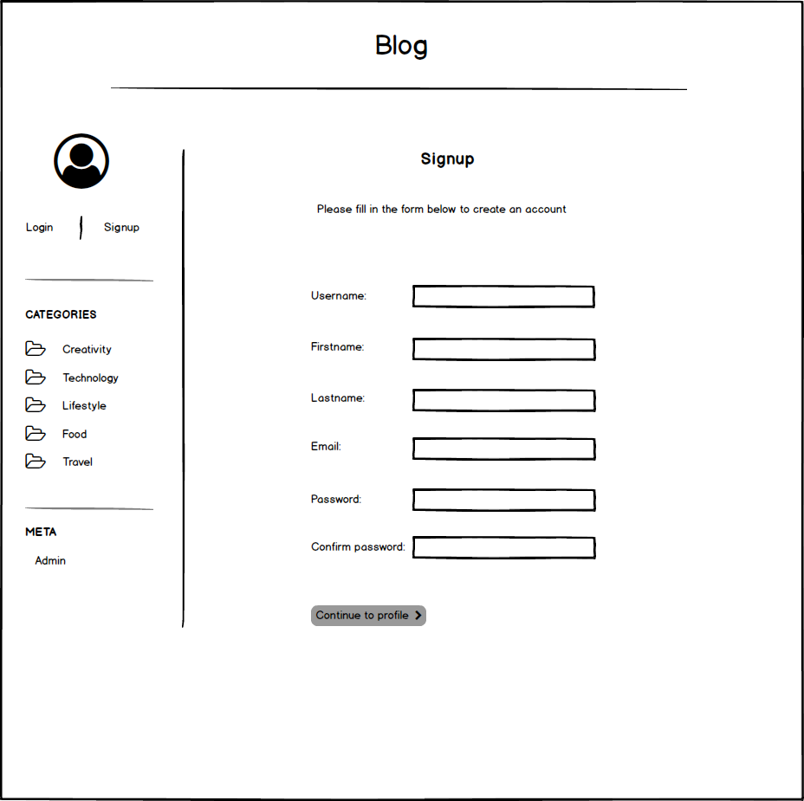
Signup page

Slide 8
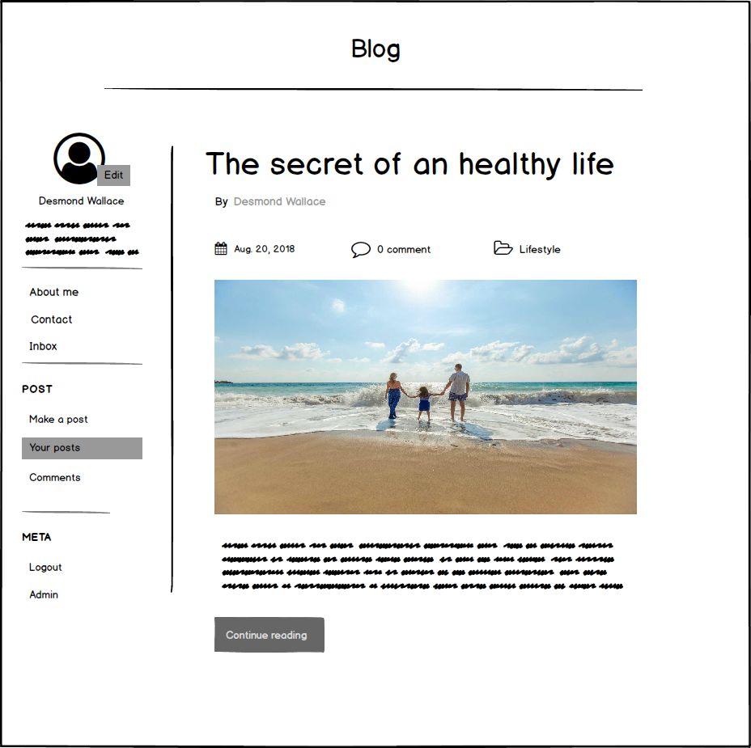
Profile page

Slide 9
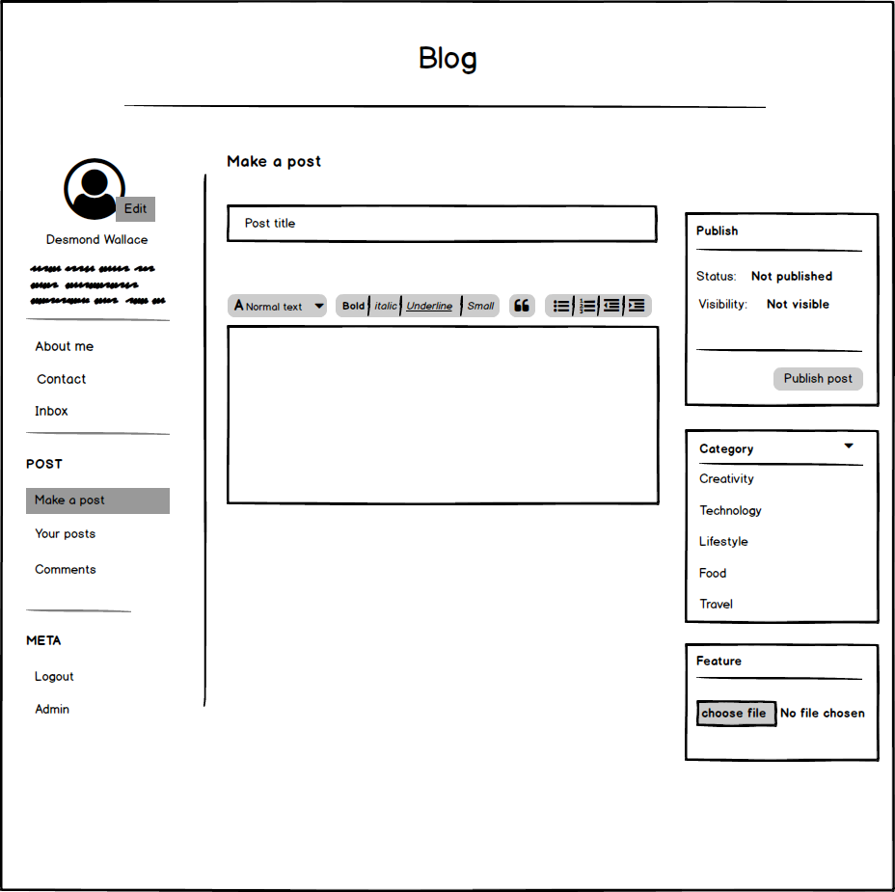
Profile – Make a post page

Slide 10
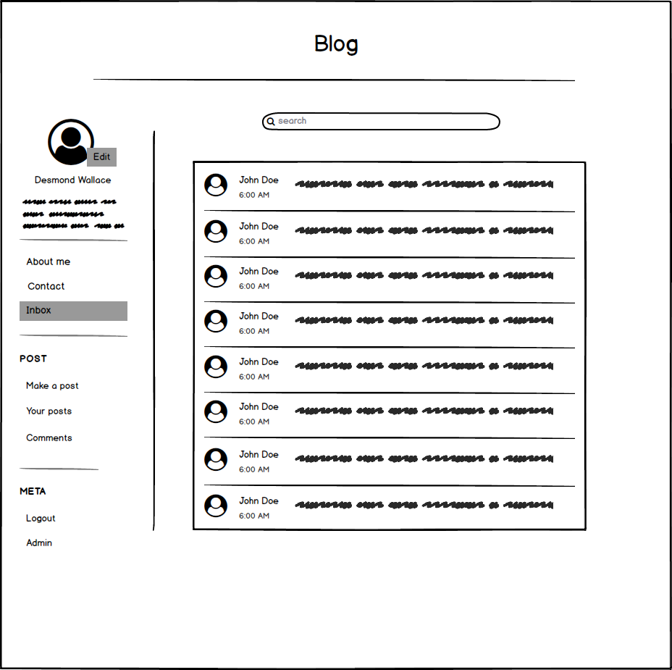
Profile – inbox page

Slide 11
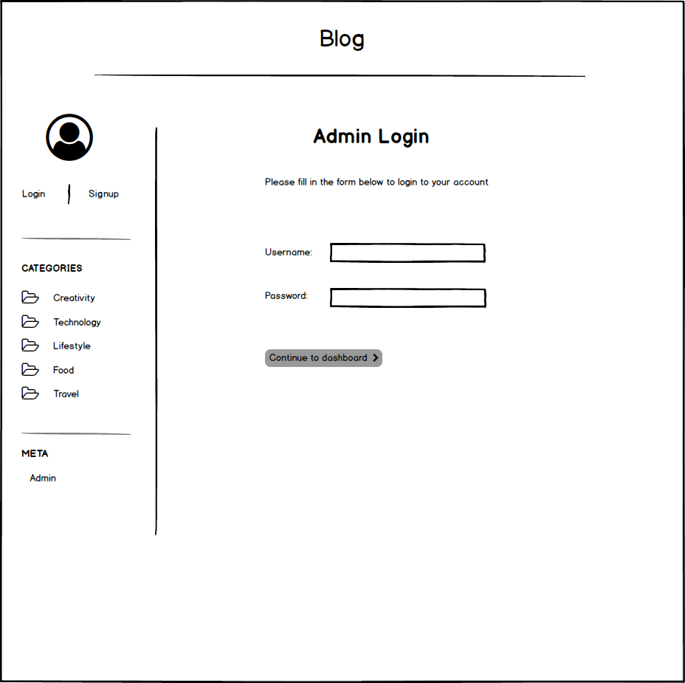
Admin – login page

Slide 12
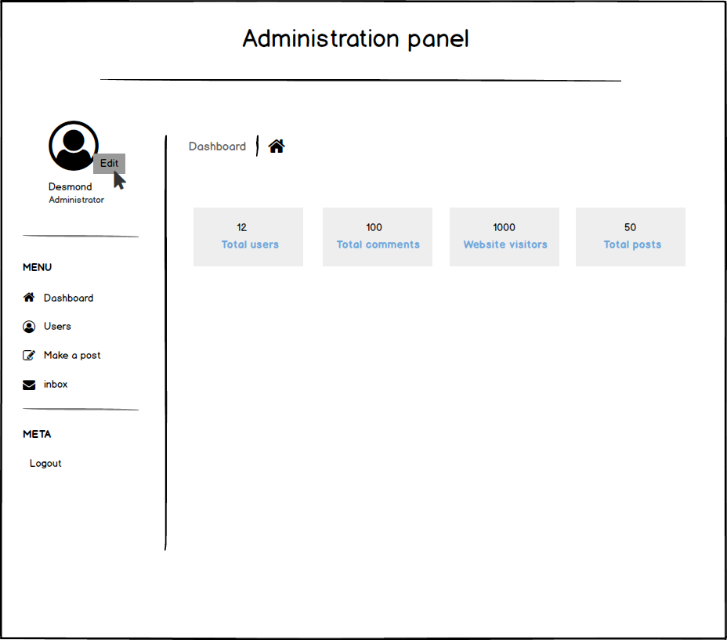
Admin – Dashboard page

Slide 13
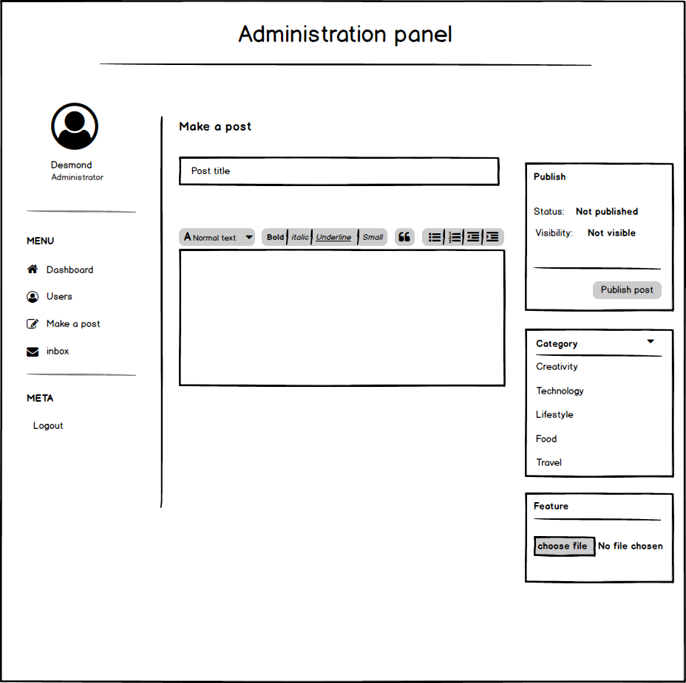
Admin – Make a post page

Slide 14
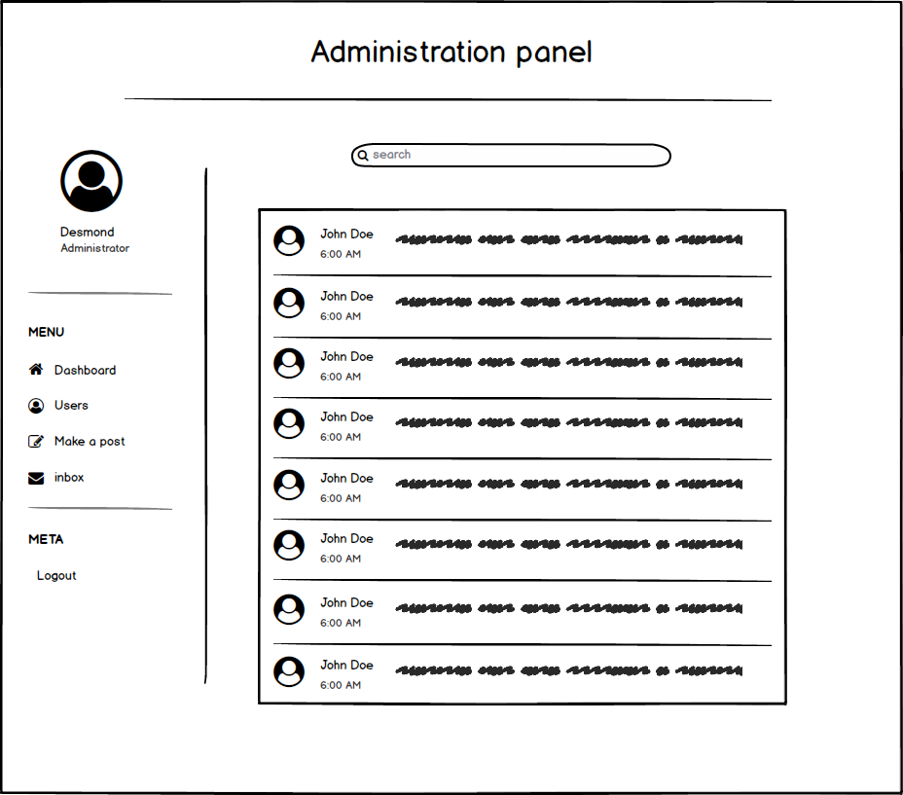
Admin – inbox page

